Slide 1

CURRICULUM VITAE OF TOWHIDA AKTER Shahjala university of science & technology, Sylhet-3114 website: http://www.sust.edu

Slide 2
contract
Mobile Phone:017********
Email: towhida07@gmail.com
Address: Ghoradia ,P/O: Narsingdi Govt College,
Narsingdi Sadar ,Narsingdi

Slide 3
Personal information Date Od Birth: 09 December, 2001 Father’s Name: Md Abdul Haque Profession: Businessman Mother’s Name: Shahnag Pervin Profession: Govt Service Holder

Slide 4

Professional summary
As a final-year BBA student majoring in Finance, I am seeking an internship in a bank as part of my academic curriculum. My goal is to apply my theoretical knowledge of financial management, banking operations, and investment analysis to real-world scenarios while gaining practical experience and developing essential skills to support my professional growth in the banking and financial services.

Slide 5
Educational background
Department of Business Administration
Major in Financing & Banking
Shahjalal University of Science and technology ,Sylhet
Session:2019-2024
CGPA-3.81(Cumulative)

Slide 6
Educational background (Con’t)
Secondary School Certificate (SSC)
Passing Year: 2017
Group : Humainities
Ghoradia High School ,Narsingdi
GPA-4.94
Higher Secondary School Certificate (HSC)
Passing Year: 2019
Group : Humainities
Narsingdi Govt. College , Narsingdi
GPA-4.96

Slide 7
project
The profitability , liquidity and sustainability of firms : a study on commercial banks of Bangladesh
Year: 2022
Author: MD mohammad Khaled rohman
Dept of business administration
Shahjal university of science & technology, Sylhet
The main objective of this study was to identify the profitability , liquidity and sustainability of the commercial banks from 2011 to 2020 which were listed on Bangladesh bank . We used various financial ratio to measure the performance and Atman’s Z score to examin the stability . The final result showed the positive and healthy growth of those firms in Bangladesh .

Slide 8
Soft skills
Communication skill | The Ability To Effectively Convey Information And Ideas To Others
Organizing skill | The Structured Arrangement Of Tasks And Resources To Achieve A Goal.
Presentation & negotiation skill | The Art Of Delivering Content Clearly And Engagingly To An Audience.

Slide 9

Technical skills
Microsoft Word
Microsoft excel
Microsoft PowerPoint
Microsoft Access

Slide 10
languages
Mother tongue: Bangla
Foreign language: English

Slide 11



interests​
Financing & Banking
Digital Marketing
Share market
Photography

Slide 12

Hobbies
Reading | Travel
Cooking | Movies

Slide 13

Extracurricular Activities
General Member of Shahjalal University Speaking Club ( SUSC)
General Member at Sowpnoutthan (Voluntary Organization)
This Photo by Unknown Author is licensed under CC BY-SA-NC

Slide 14

Achievements
Certification on Spoken English in (2017)
Certification on Computer (2017)
Certificate on Workshop on Investment In Capital Market (2024)

Slide 15
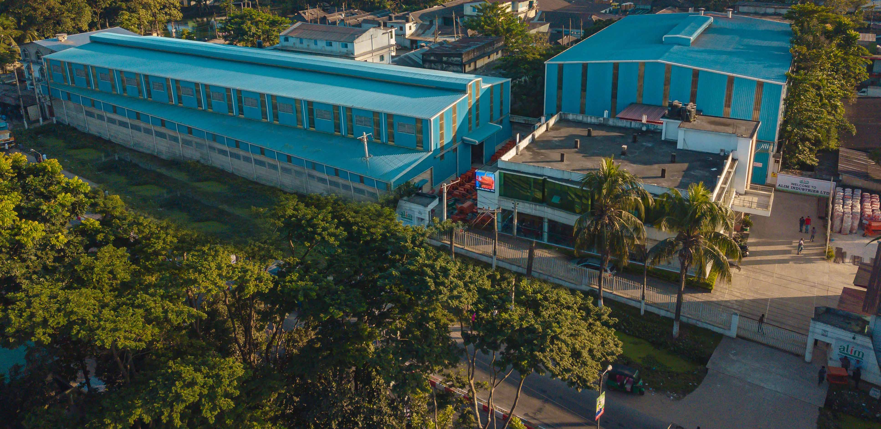
Industry exposure
Alim Industries Limited
BACIC Industrial Estate ,Sylhet
Date of Visit :December 15,2021
Observed several managerial and operational activities in different departments to gain precious knowledge.

Slide 16
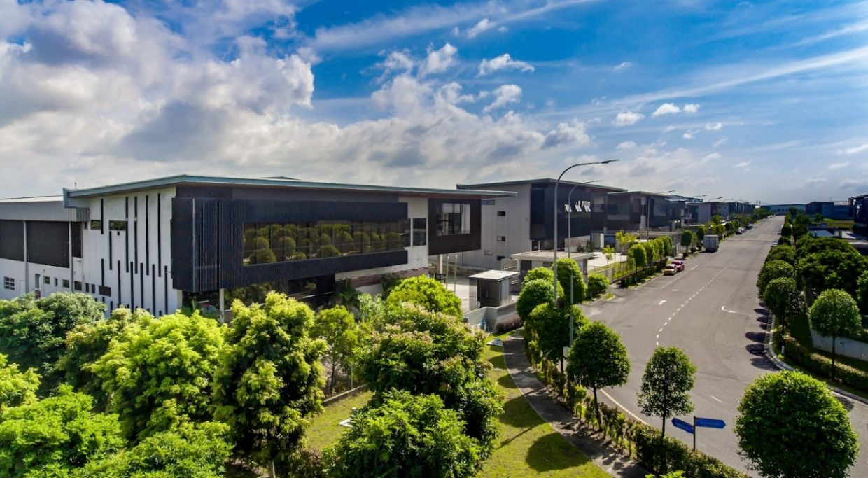
Habiganj Industrial Park
Habiganj ,Sylhet
Date of Visit: March 17,2023
Analyzed the way of working and learned about the product line management , marketing strategies, customer segmentation and so on.
Habiganj Industrial Park is a significant industrial hub established by PRAN-RFL Group, a leading conglomerate in Bangladesh. This park spans over 300 acres of land and houses a diverse range of manufacturing units, including food, beverages, plastic products, and agriculture machinery. The industrial park is highly diversified, producing everyday essentials and items with high global demand, such as transformers, electric cables, bicycles, and melamine. Between the various production lines,

Slide 17
Reference
Dr. Fazle Elahi Md. Faisal Professor Department of Business Administration, SUST Finance and Banking Email: fazle.faisal-bus@sust.edu

Slide 18
Thank you
HOME

